Slide 1

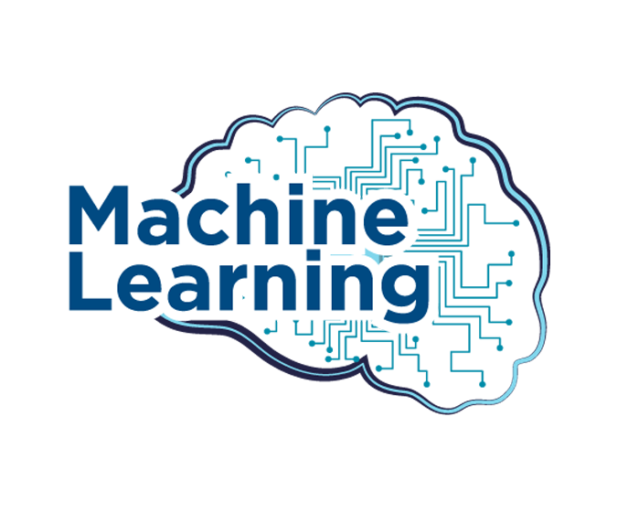
DATE :- 19/11/2024
PRESENTED BY
CHIRAG VISHVAKARMA
BCA THIRD SEMESTER
SUBMITTED TO
HOD
BCA DEPARTMENT

Slide 2
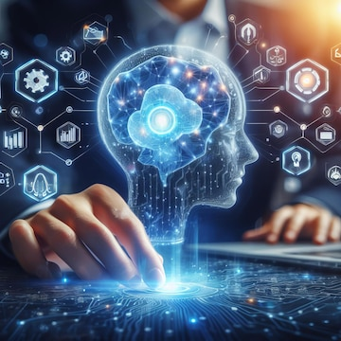

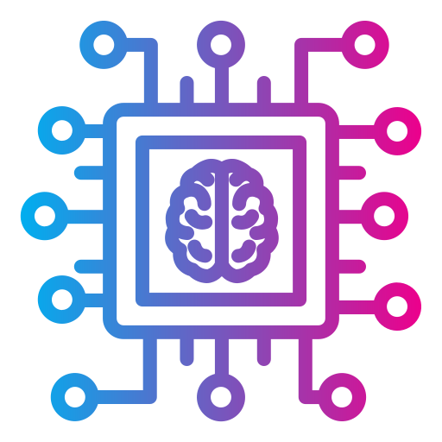
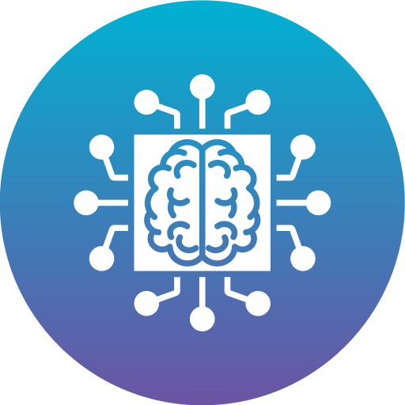
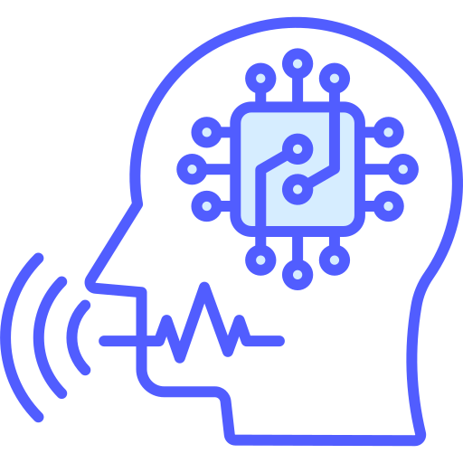

CONTENT
What is machine learning ?
How does machine learning work?
Where is machine learning used ?
Which companies use machine learning?

Slide 3
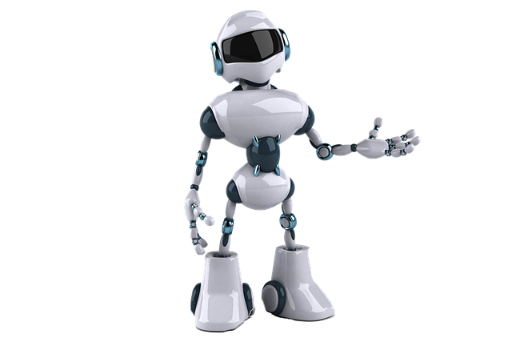
What is machine learning ?
1. Machine layering is part of AI
2. The computer is programmed in such a
way that it works according to the user.
3. Can protect user’s data and commands.

Slide 4
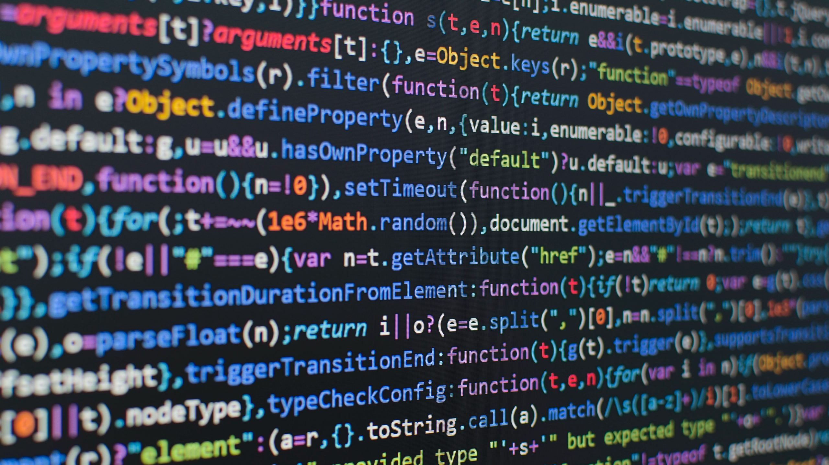
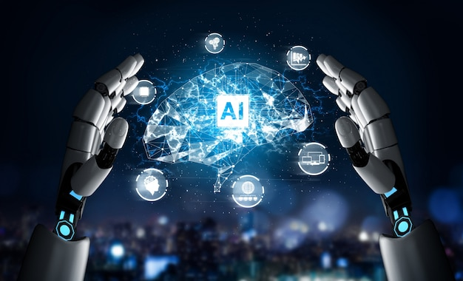
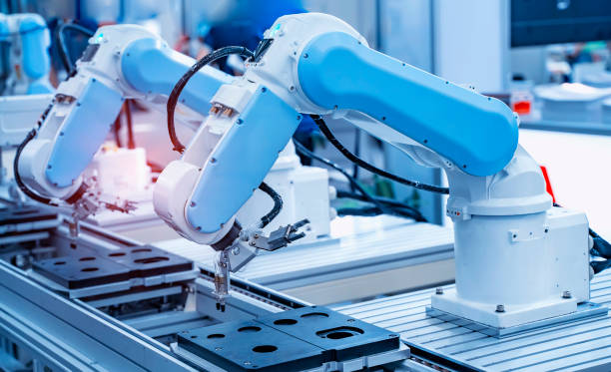
How does machine learning work?
Detects error in some cases. And corrects it.
machine learning is a form of AI.
When there is any fault in the model, it is fixed.
Defective Check

Slide 5
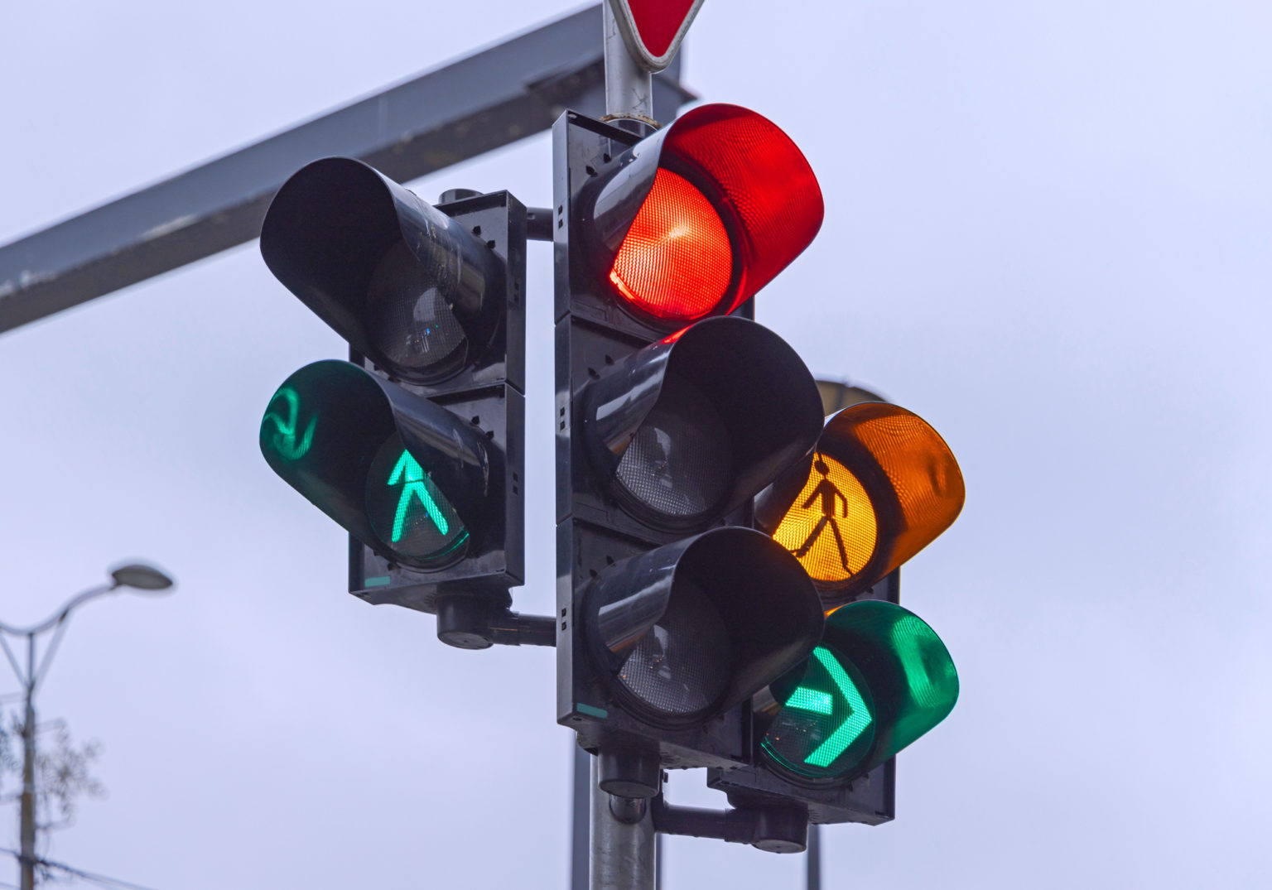
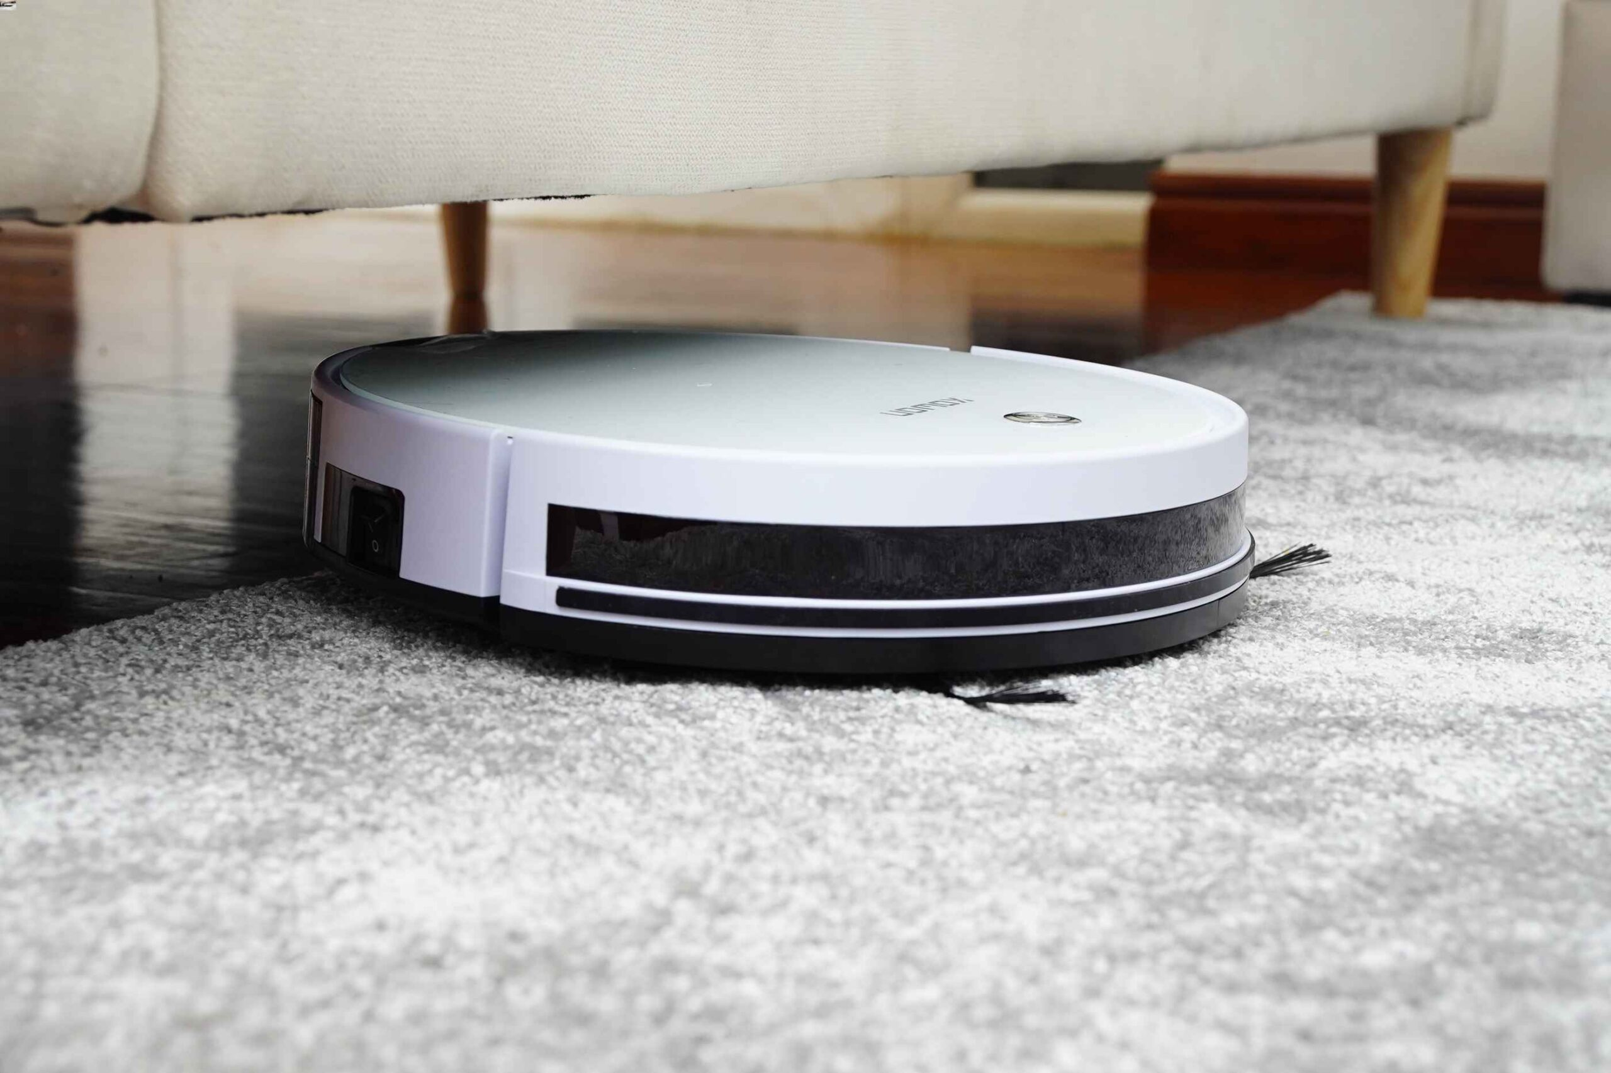
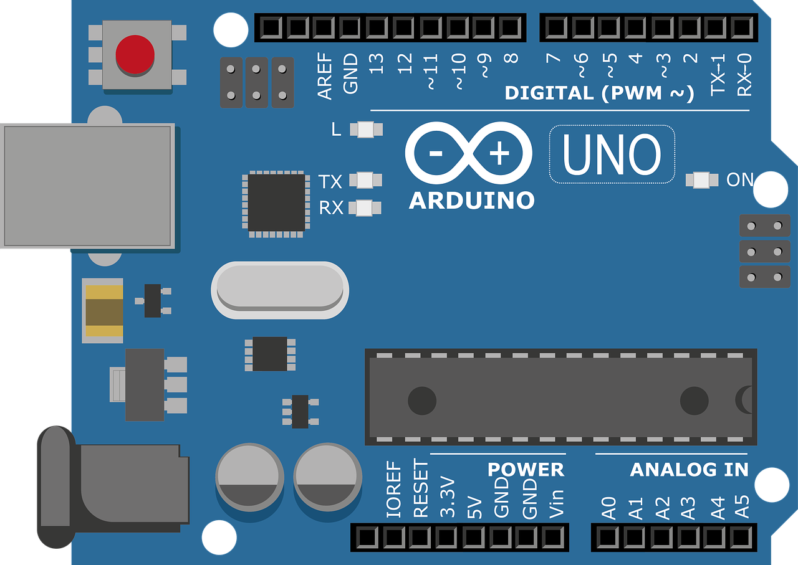
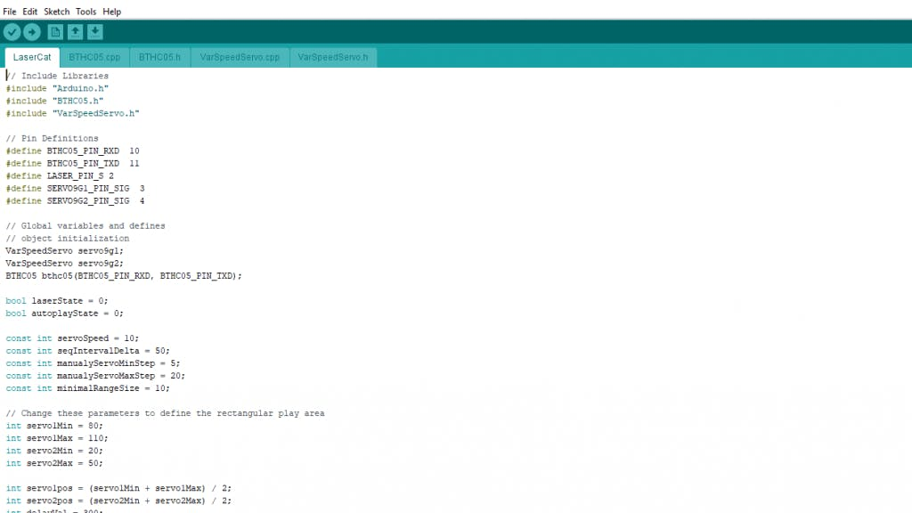

Traffic Light
Cleaner Robot
Arduino uno
Arduino code

Slide 6
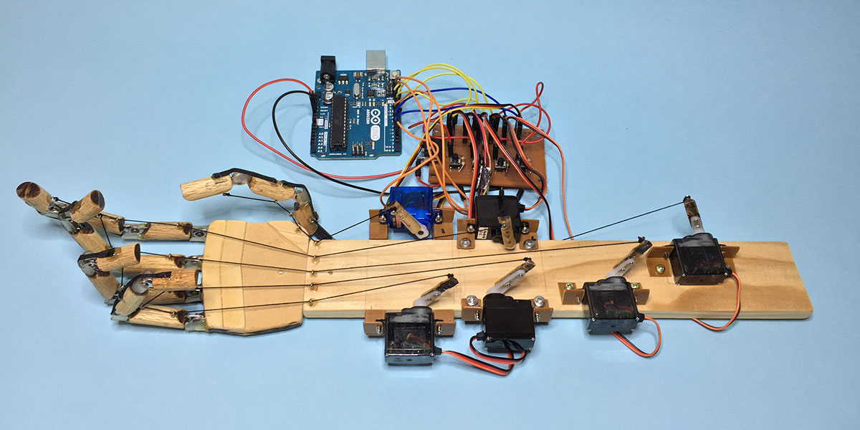

Slide 7

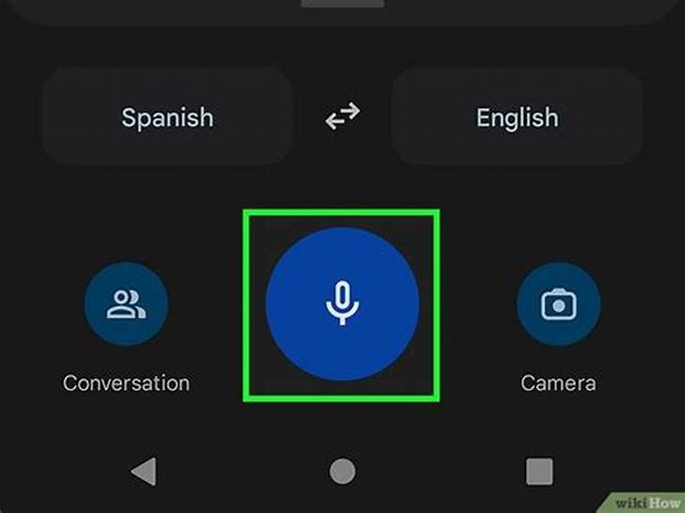


Where is machine learning used ?
machine learning is used every where.
Example :-
Google Translate
Google Translator speaker
Chat GPT

Slide 8
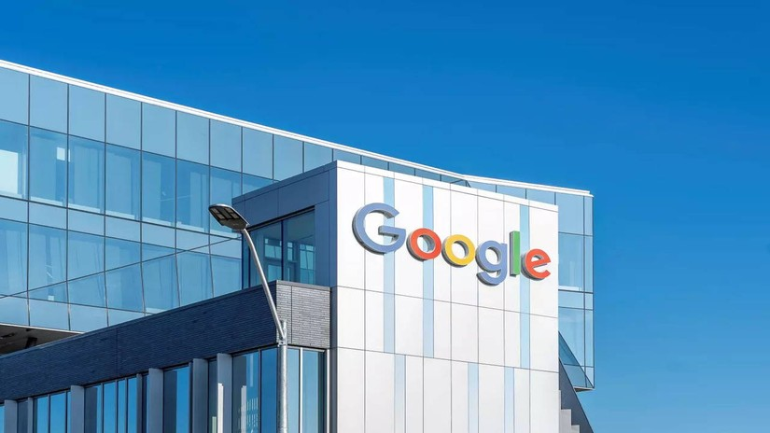


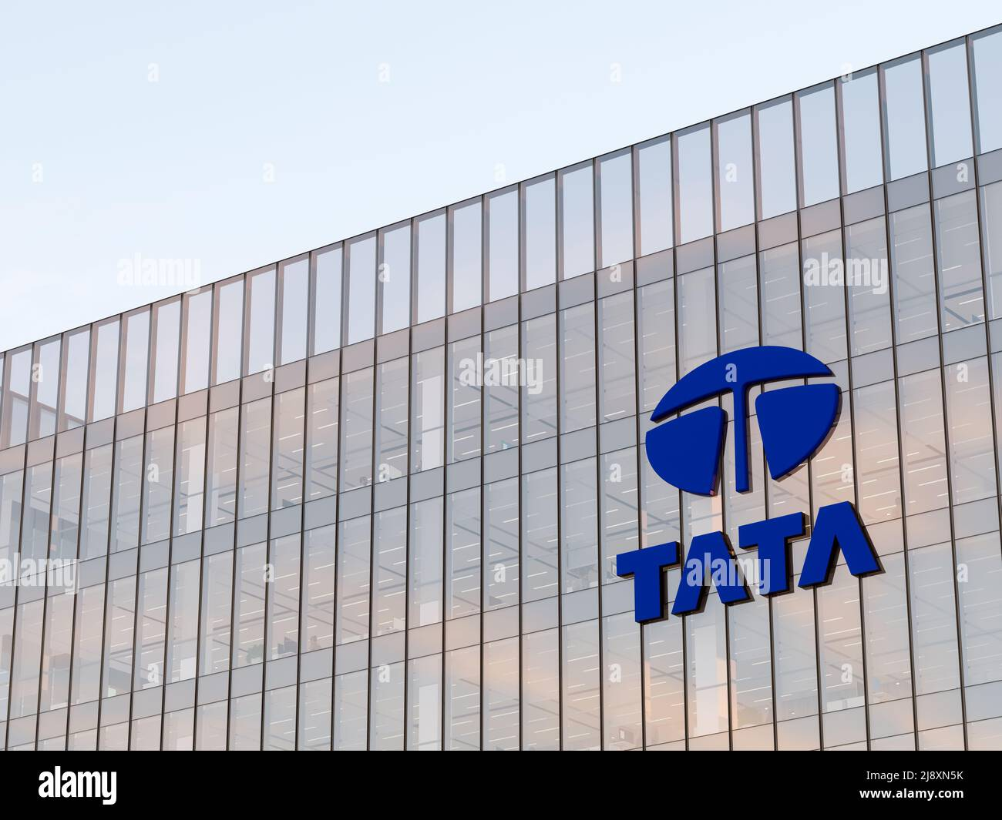
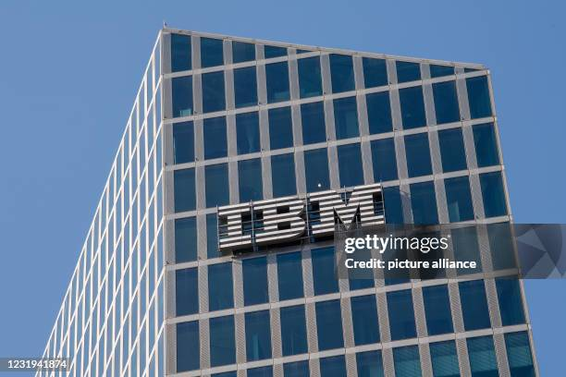
Which companies use machine learning?
GOOGLE
FACEBOOK
AWS
TATA
International Business Machines Corporation

Slide 9

Thank you

